Slide 1
Intermediate Excel – Vlookup Spring 2022

Slide 2
VLookup
Vlookup provides basic database functionality to Excel
Vlookup looks up a value in a range and returns the contents of a cell in that row.

Slide 3
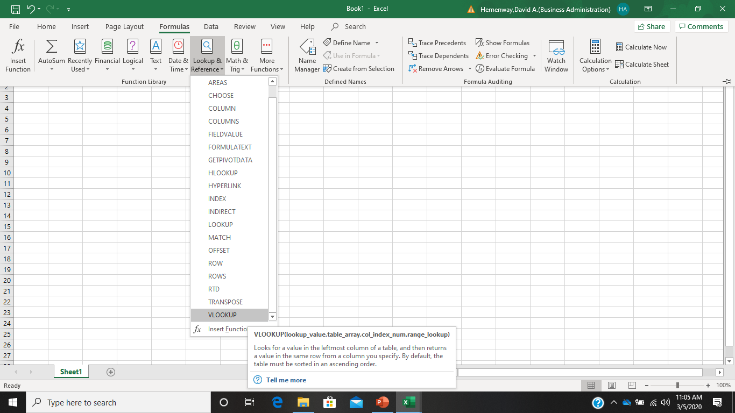

Slide 4
Two Key VLookup Concepts
Lookup Value: The cell where you type what you want to look up. There is never a formula in this cell. It is like the search bar in Google.
The Vlookup Formula: Where you place the Vlookup instructions that result in a value.

Slide 5
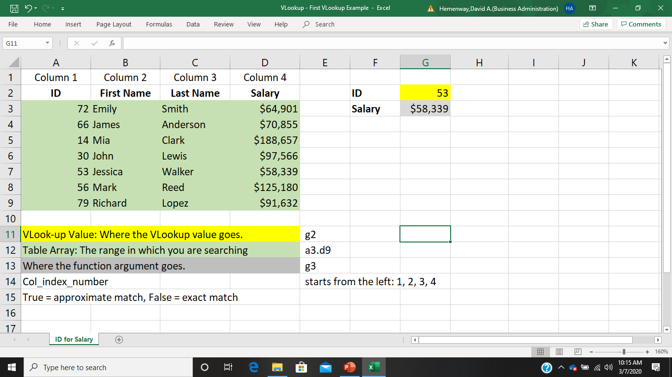
VLookup First Example

Slide 6
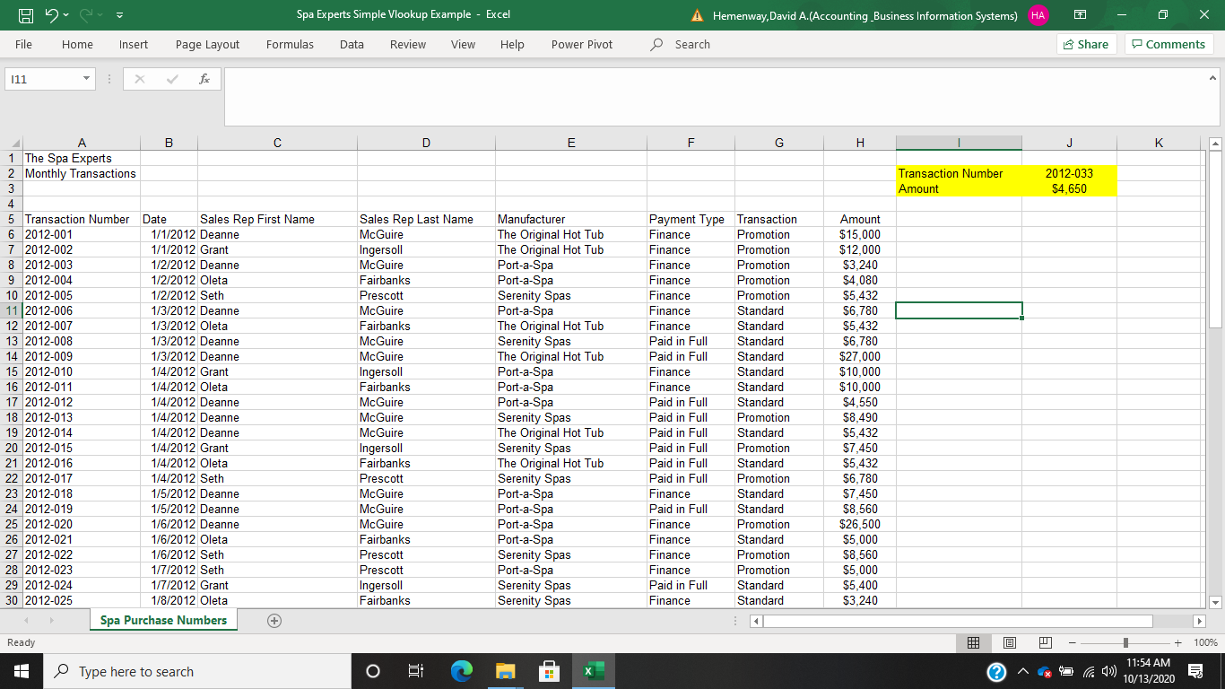
Vlookup - Spa Experts Simple Example

Slide 7
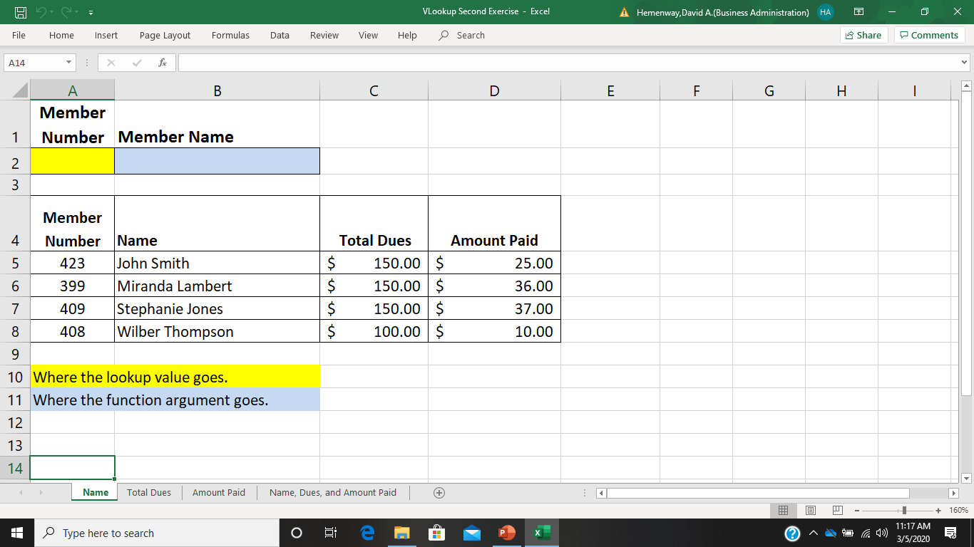
Vlookup – First Exercise

Slide 8
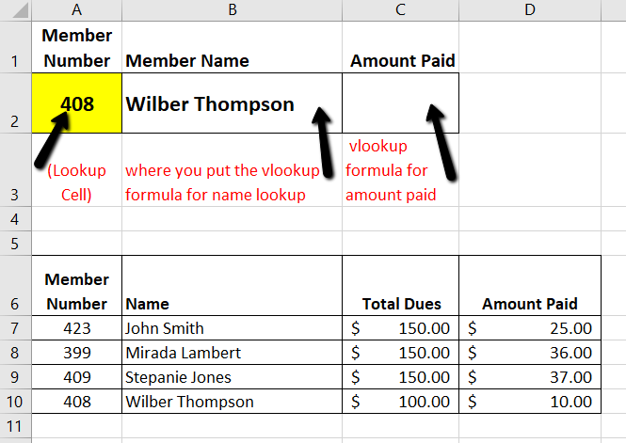
The VLookup Formula
=VLOOKUP(A2,NAMES,2,FALSE)
Lookup value is A2, the range is NAMES, get field from col 2 of Names, get this only if the lookup value is an exact match

Slide 9
You’re the HR Director of Bank of America
You have a list of people who have applied for teller jobs across America.
You also have a list of some notorious bank robbers.
You want to make sure that no bank robber is hired as a teller.
Download the VLookup Bank Robbers file and determine who on the list of bank teller applicants are also on the bank robbers list.

Slide 10
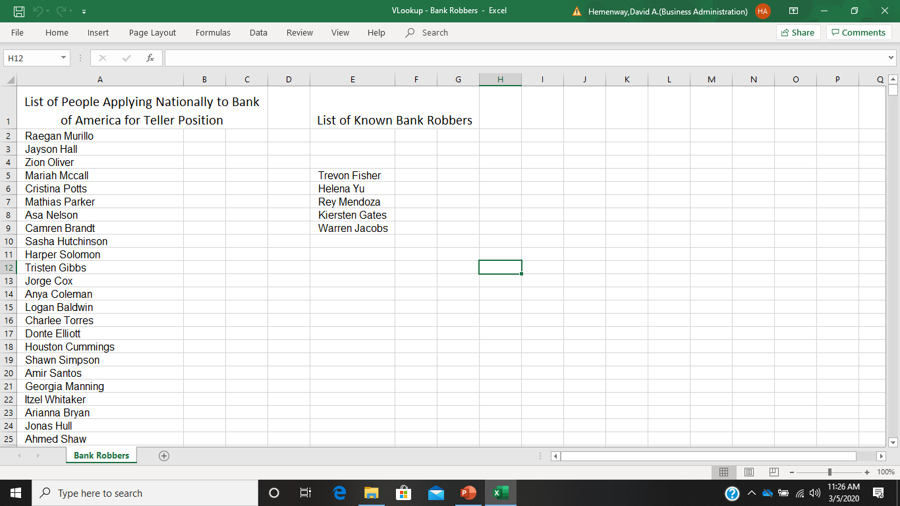
VLookup - Bank Robbers

Slide 11
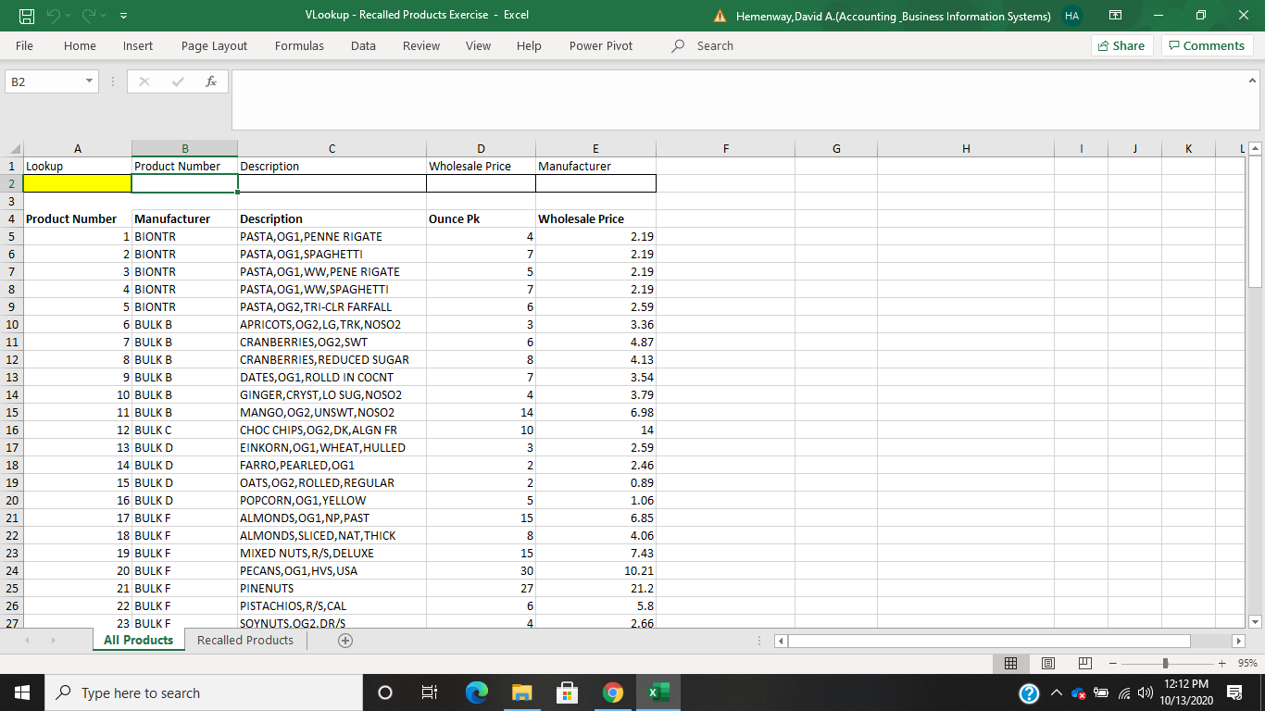
Vlookup - Recalled Products Exercise

Slide 12
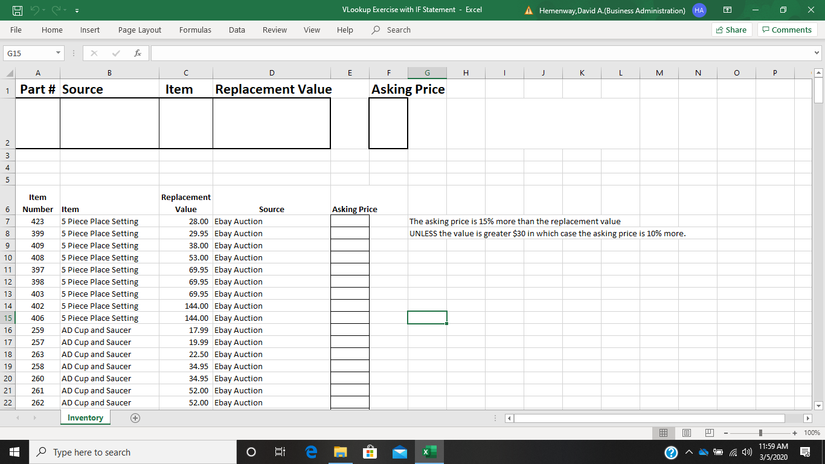
Vlookup Exercise with IF statement Use VLookup and IF to Complete

